Slide 1
Introduction to Renewable Energy Sources
Renewable energy refers to energy produced from natural resources that are continuously replenished on a human timescale.
Unlike fossil fuels such as coal, oil, and natural gas—which are finite and contribute to pollution—renewable energy sources are cleaner, more sustainable, and environmentally friendly.

Slide 2
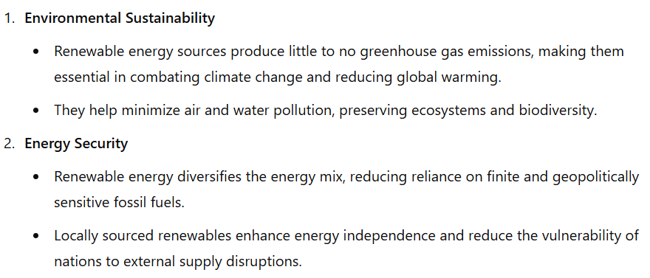
Need of renewable energy

Slide 3
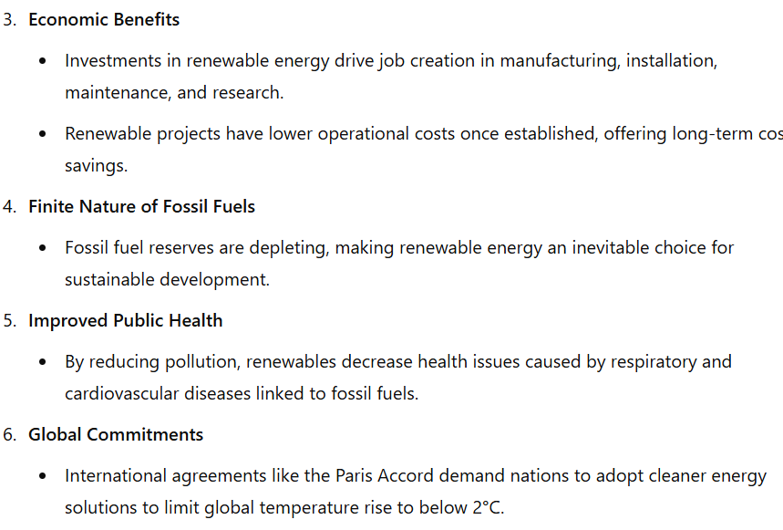
Need of renewable energy

Slide 4
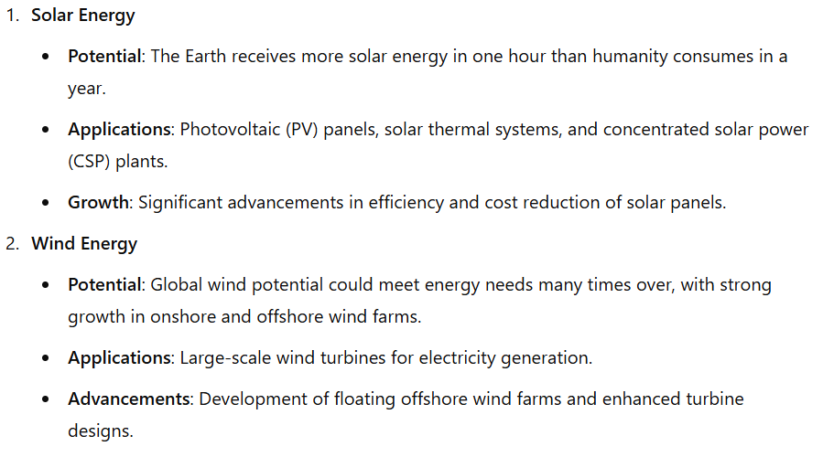
Potential of renewable energy sources

Slide 5
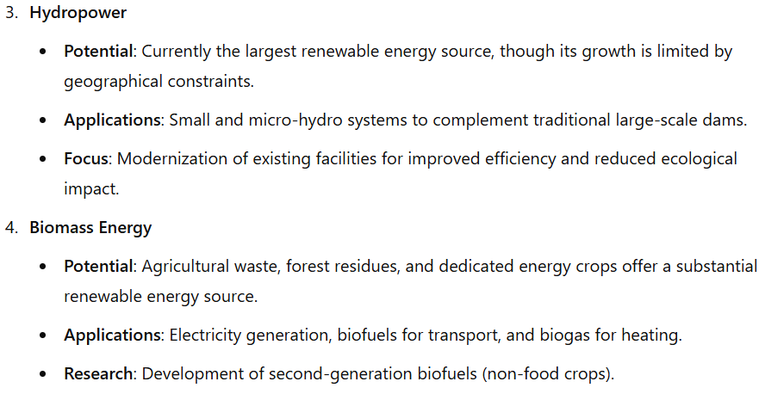
Potential of renewable energy sources

Slide 6
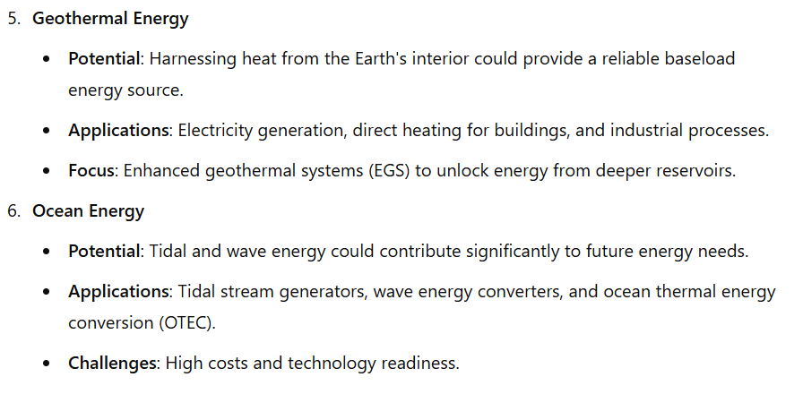
Potential of renewable energy sources

